Slide 1



: a platform for conducting remote web interaction studies
Henry Feild
Endicott College
November 15, 2013
James Allan

Slide 2
Things we like to do in IR
Observe and model user behavior
Compare search algorithms / interfaces
which do users prefer?
time to completion
which result in more/fewer clicks, etc.
Modeling and Measuring the Impact of Short and Long-Term Behavior on Search Personalization
Personalization of Search Results Using Interaction Behaviors in Search Sessions
Improving Searcher Models Using Mouse Cursor Activity
Search, Interrupted: Understanding and Predicting Search Task Continuation
User Evaluation of Query Quality
Absence time and user engagement: Evaluating Ranking Functions
Optimized Interleaving for Online Retrieval Evaluation

Slide 3
What's currently done client-side
build toolbar
run study
recruit participants via fliers, classes, etc.
lab studies
in situ (install at home)
install on campus computers
free recruitment, but library-biased
This is slow, expensive, and generally a lot of effort

Slide 4
What we want
a common, open source platform that deals with the basics
interaction data collection
data storage
privacy
a common user base
can recruit some new users, but already have a significant pool of participants
an interface for implementing novel studies

Slide 5
What is CrowdLogger?
CrowdLogger in action
Cross your fingers!
…don’t worry, I have screenshots just in case…☺
Issues / Next steps

Slide 6
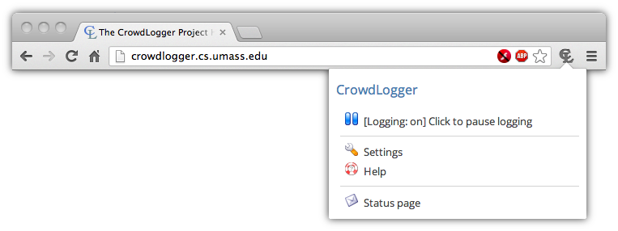



CrowdLogger instance server
(e.g., http://crowdlogger.org)
App
App
App Repository
App Repository
Log
App Repository
App
App
App
Log
App
Log

Slide 7


Advantages
User Base = Participant Pool
Rich API
Allows apps to
access current
and historical browsing behavior, store data, interact with the user, upload data privately, and more!
CrowdLogger instance server
App
Log
Apps can be developed by anyone
Open Source
App Repository
And distributed from a private repository, or a CrowdLogger server instance.
The entire code base is available from our Google Project page: https://code.google.com/p/crowdlogger/
App
App
Users’ data logged locally
Multiple apps at the same time
If an app wants to upload data somewhere else, they need permission from the user.
App
App
CrowdLogger is somewhat akin to a smart phone or tablet—it’s an extensible, general-purpose platform with a convenient API.
Log

Slide 8
API Categories
User Data
Aggregate User Data*
Historical data
- get all clicks
- get all searches
Real time data
- on new search, do …
Already collected data
- get all query rewrites
- get all query-click pairs
User Interface
Uploading/Privacy
x
Modify web pages
- inject JavaScript into pages*
Stand-alone windows/pages
- present dialog when user searches
- modify search page ranking
Encryption
Anonymization & aggregation
- upload via anonymizers
- privately aggregate data
Client-server communication
Local data storage
Request server-side computation
- run retrieval algorithm for query
Access server-side data
- send me synonyms for …
...
Save data locally
- settings
- models

Slide 9

CrowdLogger Remote Modules
Also called: CLRMs or Apps
Parts of an App:
Core code
Core files
Set of JavaScript files that are run
continuously in the background
Resources
HTML, JavaScript, CSS, images*, etc.
CLI
CLRMI
App
App
…
App

Slide 10
App Example—JSON
{
"metadata": {
"clrmid": "demo1",
"name": "Demo 1",
"version": "1.6",
"categories": [
"app"
],
"description": "A simple CrowdLogger Remote Module demonstration. It shows off the ability to open windows, access user data, and use the storage API.",
"packageURL": "http://localhost/~hfeild/test-clrms/demo/demo.json",
"permissions": [
"userdata",
"ui",
"storage"
],
"logoURL": http://localhost/~hfeild/test-clrms/demo/demo.jpg
},
"module": "\nvar RemoteModule = function( clrmPackage, clrmAPI ){\n var demo,\n that = this;\n\n this.init = function(){\n demo = new that.Demo( clrmPackage, clrmAPI );…”,
"html": {
"configure-demo.html": "<html>\n<head>\n<title>CLRM Configure Demo</title>…
},
"js": {
"init.js": "\n// This gets set by our opener. It's our connection to the core CLRM…
}
"css": {
"demo.css": "\nbody {\n background: white;\n color: #555;\n}\n\n#interactions, #searches, #user-input {\n width: 100%;\n height: 20%;\n overflow: auto;\n background-color: #ddd;\n border: 1px solid #888;\n}\n\n.notice {\n display: none;\n}\n\n.success {\n color: green;\n}\n\n.error {\n color: red;\n}"
},
"misc": {}
}

Slide 11

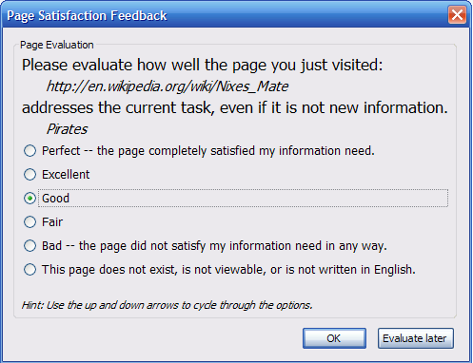
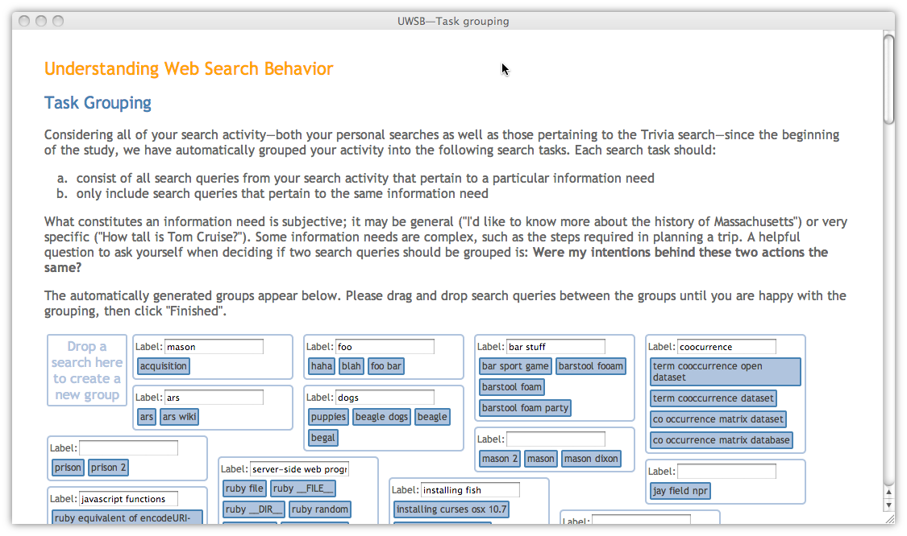
Interactive experiments
System comparisons
Explicit feedback
Labeling

Slide 12
Privacy
Uploading data (study-specific)
Collecting aggregated data (via the API)
k-Anonymity
If mining queries and k=20, only the ones in orange are revealed
Only in aggregated, no two pieces of information revealed separately are ever tied together
weather
google
directions to chapel hill
mac power cord
mac power adapter
…
100 other users
200 other users
1 other user
10 other user
50 other user
Differential Privacy
Says: we shouldn’t be able to tell if a user’s data was or was not part of the dataset based on what is released

Slide 13
What is CrowdLogger?
CrowdLogger in action
Cross your fingers!
…don’t worry, I have screenshots just in case…☺
Issues / Next steps

Slide 14
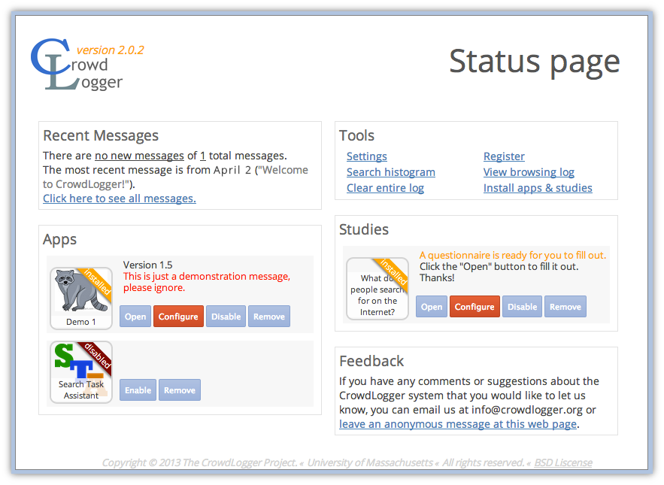

Slide 15
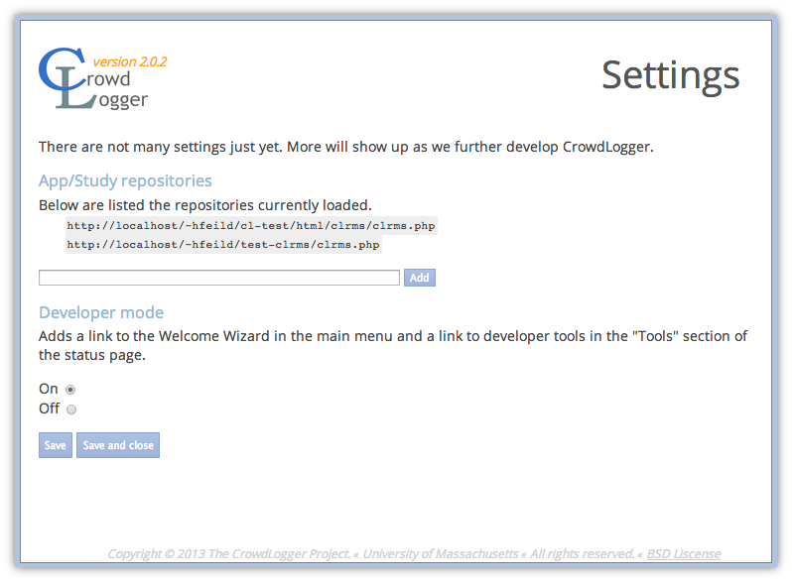

Slide 16
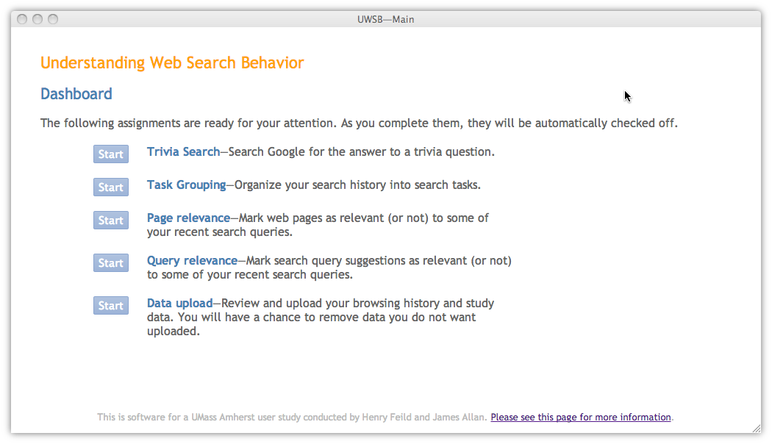
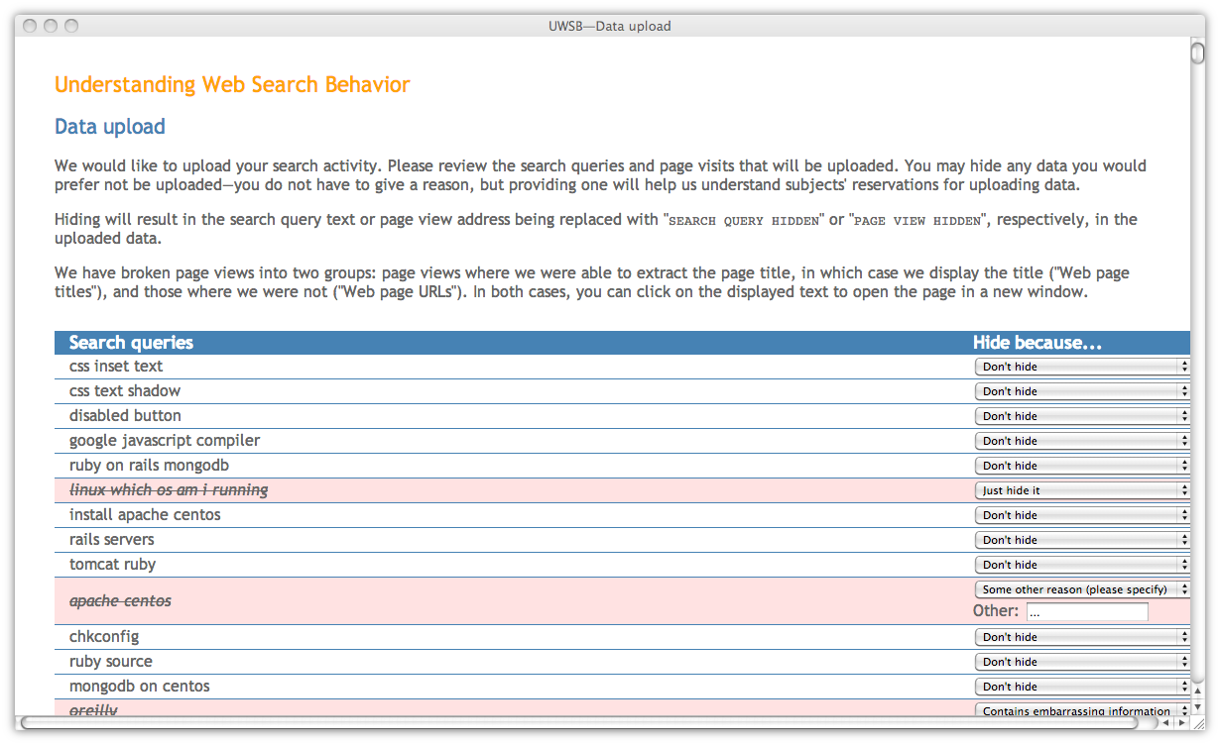

Slide 17
What is CrowdLogger?
CrowdLogger in action
Cross your fingers!
…don’t worry, I have screenshots just in case…☺
Issues / Next steps

Slide 18
Challenges/Future work
Amassing a large user base
Complete/Extend API
How do we attract and retain users?
There are still a
few API classes that
we have yet to implement, such as global aggregation of data. There are also many things we can and probably should add to improve utility.
CrowdLogger instance server
App
Log
Simplifying app development
Attracting developers
App Repository
We’d like to make it easy for research groups with minimal programming skills to build and deploy apps
It’s good for the development process to be overseen by more than one pair of eyes. This will make the code more maintainable and also more secure.
App
App
Logging across more browsers
Handling multi-apps environments
Right now we only support two of the leading browsers. It would be nice to extend CrowdLogger to IE, Safari, Opera, and others.
App
App
What happens if two studies are running concurrently, and both modify the browsing UI?
Log

Slide 19
App builder
[See demo]
Good for:
Starting from existing apps
Rapid development
Less messing around with the nitty gritty
Research groups without technical support/programming skills

Slide 20

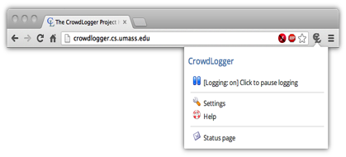
Local web server
App repository
App repository
Server
Participant’s computer
DB
App
App
Browser w/ light extension
…
Local web server

Slide 21
Chrome extension installation
“Google to block local Chrome extensions on Windows starting in January, limit installs to the Chrome Web Store”
…uh oh…
Solutions:
get CrowdLogger approved for inclusion in Google Web Store
implement local server model
get light extension approved for inclusion in Google Web Store
release a modified version of Chromium (open source Chrome) for our Chrome users
http://thenextweb.com/google/2013/11/07/google-block-local-chrome-extensions-windows-starting-january-limit-installs-chrome-web-store/

Slide 22
Diverse privacy controls
What will be collected:
All search reformulations. For example, if you search for “blueberry pie” and then “blueberry pie recipes”, the pair:
“blueberry pie”, “blueberry pie recipes”
will be collected.
How the collected data will be used:
Reformulations will be anonymized and made publically accessible and used to, for example, generate search suggestions for you and other users.
Privacy settings:
For each search reformulation collected from you, select the anonymization level: the number of other users that must also share the same reformulation for it to be included in the final data set:
4
I have read the consent form and agree to participate in this study.
Cancel
Continue

Slide 23
Diverse privacy controls
what data get's shared with researchers?
under what conditions?
What data is being collected and how it will be used
What is minimally useful to researchers
What users are comfortable with
Query rewrites for public release | Whatever users are comfortable with | User 1: only if shared by 9+ other users (k=10) User 2: k=1 rewrites
Feedback on retrieval system preference for researcher use only | k=1 anonymized feedback from users | User 1: k=5 feedback User 2: k=1 feedback

Slide 24

Incentivization
Provide a service
- research prototypes
- visualizations
- re-finding tools
- citizen scientist
Google Search History
Financial incentives
- gift cards
- virtual currency to ‘buy’ research apps
Search Task Assistant
Gamification
- study-specific
- could also be a service
EPS game
Google-a-day

Slide 25
Thanks!
If you’d like to help develop, let me know!
Hank Feild: hfeild@endicott.edu
CrowdLogger:
Instance server: http://crowdlogger.org
Git repo: https://code.google.com/p/crowdlogger/
Google group: https://groups.google.com/forum/#!forum/crowdlogger-project-news

