Slide 1



Using for In Situ Information Retrieval System Evaluation
Henry Feild—Endicott College
James Allan—UMass Amherst
November 1, 2013
Living Labs Workshop @ CIKM

Slide 2
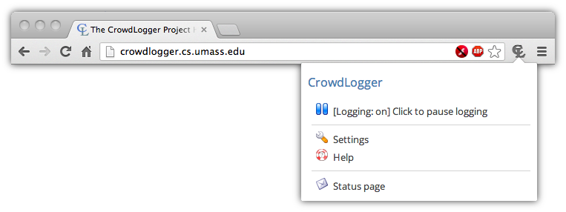


CrowdLogger instance server
(e.g., http://crowdlogger.org)
App
App
App Repository
App Repository
Log
App Repository
App
App
App
Log
App
Log

Slide 3

Advantages
User Base = Participant Pool
Rich API
Allows apps to
access current
and historical browsing behavior, store data, interact with the user, upload data privately, and more!
CrowdLogger instance server
App
Log
Apps can be developed by anyone
Open Source
App Repository
And distributed from a private repository, or a CrowdLogger server instance.
The entire code base is available from our Google Project page: https://code.google.com/p/crowdlogger/
App
App
Users’ data logged locally
Multiple apps at the same time
If an app wants to upload data somewhere else, they need permission from the user.
App
App
CrowdLogger is somewhat akin to a smart phone or tablet—it’s an extensible, general-purpose platform with a convenient API.
Log

Slide 4
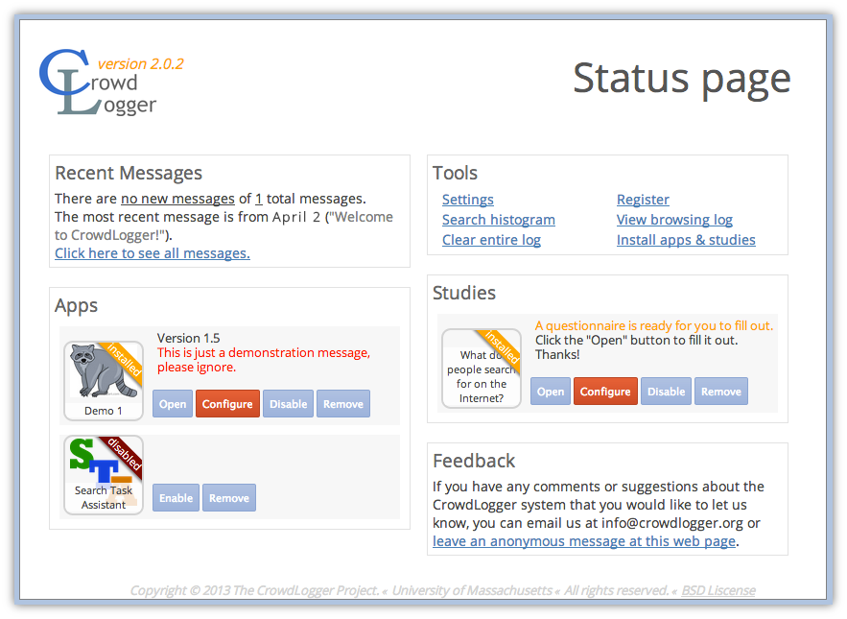

Slide 5
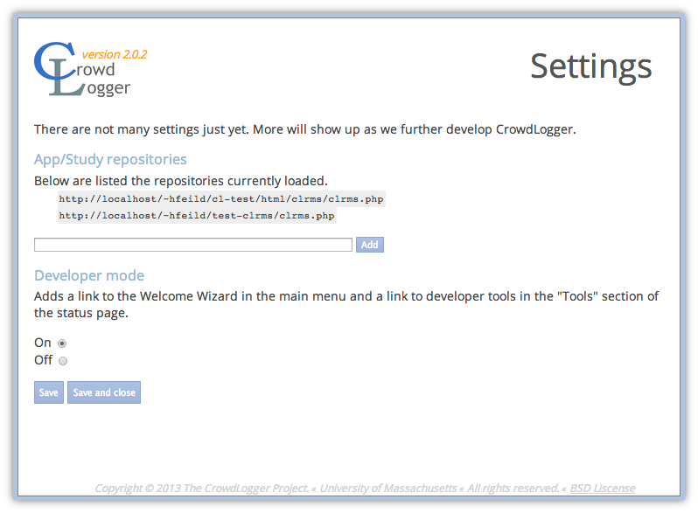

Slide 6
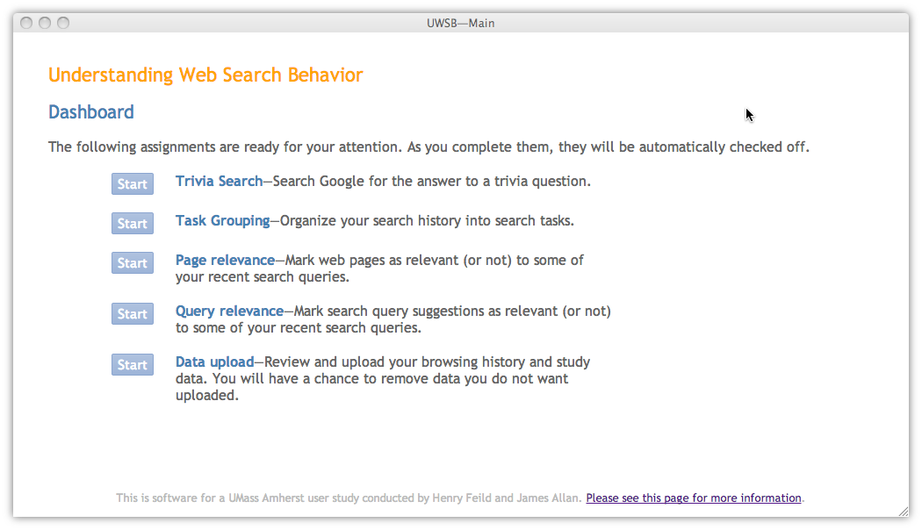
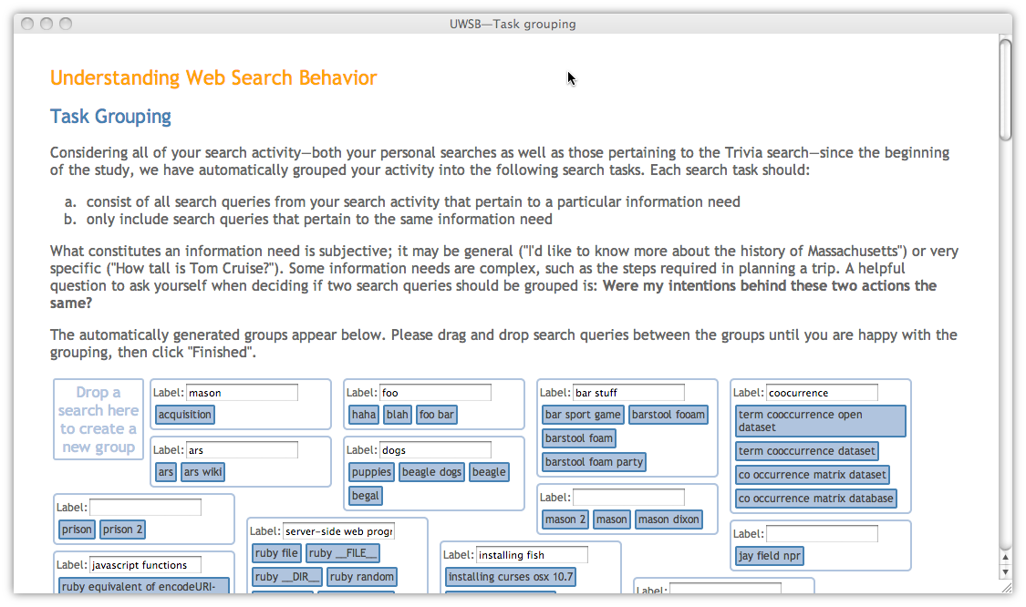
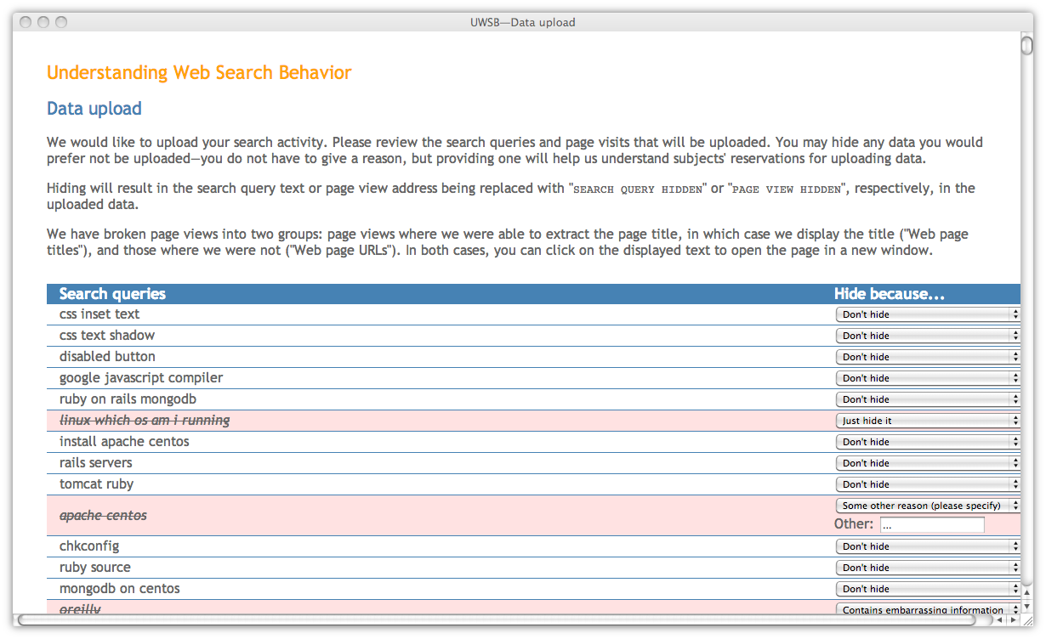

Slide 7
Challenges/Future work
Amassing a large user base
Complete/Extend API
How do we attract and retain users?
There are still a
few API classes that
we have yet to implement, such as global aggregation of data. There are also many things we can and probably should add to improve utility.
CrowdLogger instance server
App
Log
Simplifying app development
Attracting developers
App Repository
We’d like to make it easy for research groups with minimal programming skills to build and deploy apps
It’s good for the development process to be overseen by more than one pair of eyes. This will make the code more maintainable and also more secure.
App
App
Logging across more browsers
Handling multi-apps environments
Right now we only support two of the leading browsers. It would be nice to extend CrowdLogger to IE, Safari, Opera, and others.
App
App
What happens if two studies are running concurrently, and both modify the browsing UI?
Log

