Slide 1
Logging the Search Self-Efficacy of Amazon Mechanical Turkers
Henry Feild* (UMass)
Rosie Jones* (Akamai)
Robert Miller (MIT)
Rajeev Nayak (MIT)
Elizabeth Churchill (Yahoo!)
Emre Velipasaoglu (Yahoo!)
July 23, 2010
* Work done while at Yahoo!

Slide 2
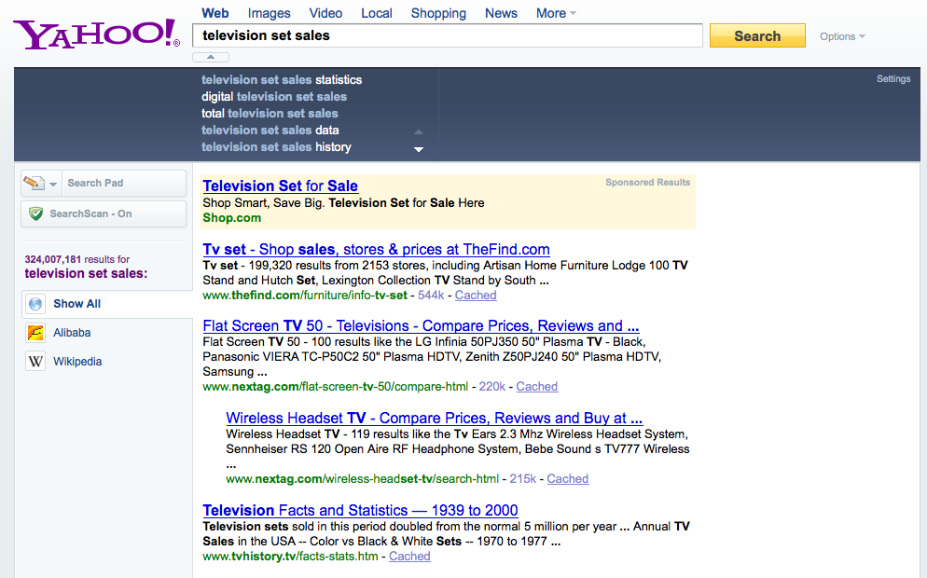
Imagine you are frustrated searching and think you are a good searcher...
✗ ✔
✗ ✔
✗ ✔
✗ ✔

Slide 3
Imagine you are frustrated searching and think you area good searcher...
bad
✗ ✔
✗ ✔
✗ ✔
✗ ✔

Slide 4
Outline
What we’re trying to do
Search self-efficacy
Searcher frustration
Search Assistance
AMT – why use it?
Initial experiments
Challenges

Slide 5
What we’re trying to do
What relationships exist between:
a user’s search self-efficacy,
their current level of search frustration,
and what search assistance they find most helpful

Slide 6
Search self-efficacy
how good of a searcher one perceives themselves to be
measured using a scale
related work: Diane Kelly [Tech report, 2010]
I can...
Find articles similar in quality to those obtained by a professional searcher.
Devise a query which will result in a very small percentage of irrelevant items on my list.
...

Slide 7
Searcher Frustration
how frustrated a user is while searching for an information need
measured using a scale
example:
What was the best selling TV model in 2008?
television set sales 2008
“television set” sales 2008
“television” sales 2008
google trends
“television” sales statistics 2008
user got frustrated starting here

Slide 8


Search Assistance
a tool that assists with search
examples:
suggest as you type
query suggestions
relevance feedback
✗ ✔

Slide 9
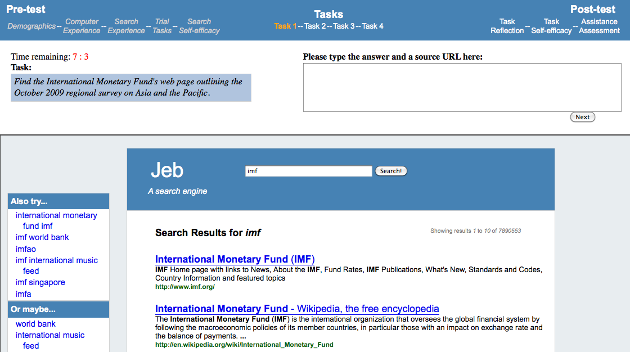
Study platform

Slide 10
Outline
What we’re trying to do
Search self-efficacy
Searcher frustration
Search Assistance
AMT – why use it?
Initial experiments
Challenges

Slide 11
AMT – Why use it?
we can cover a lot more people
can be more cost effective
easier recruitment
quicker turn-around
can run it over night
makes iterative development quick and simple
more diverse than university setting

Slide 12
Diversity
As of May 2009 Ross et al. [CHI 2010]
~ 40% Bachelors, ~ 20% Graduate
~ 50/50 gender split
56% US, 36% India, 8% other
Maybe diverse search self-efficacy, too?
college students have high search self-efficacy (Kelly 2010)

Slide 13
Outline
What we’re trying to do
Search self-efficacy
Searcher frustration
Search Assistance
AMT – why use it?
Initial experiments
Challenges

Slide 14
Initial experiments – Motives
what is the spread of search self-efficacy across Turkers?
how does price / HIT affect speed and spread?

Slide 15
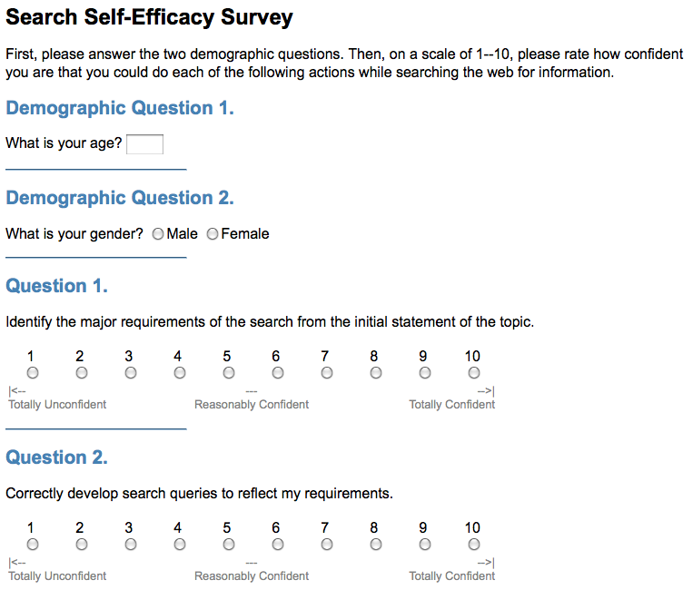
HIT
HIT: search self-efficacy questionnaire
Two versions:
100 x $0.50
100 x $0.05
released at 8:30pm on two Mondays in June
...

Slide 16
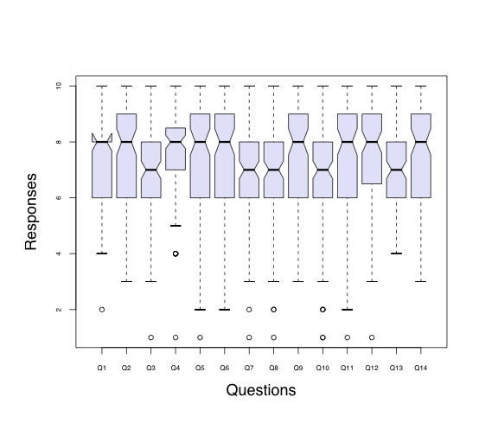
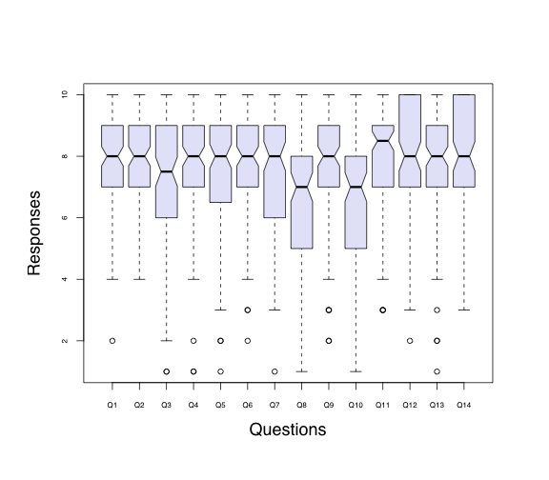
Search self-efficacy spread
$0.50 / questionnaire
$0.05 / questionnaire

Slide 17
Time for all 100 HITs to be accepted

Slide 18
Time to complete questionnaire

Slide 19
Hourly wage
HIT version | Median completion time | Median hourly wage
$0.50 | 117.5 seconds | $15.31
$0.05 | 92.5 seconds | $1.95
Gave a bonus of $0.17 – raises median wage to: $8.55 / hour

Slide 20
Outline
What we’re trying to do
Search self-efficacy
Searcher frustration
Search Assistance
AMT – why use it?
Initial experiments
Challenges

Slide 21
Search self-efficacy scale challenges
modify to ask positive and negative versions of queries
allows us to check if users are paying attention
inconsistent results raise a poor-quality flag
could ask both versions of each question
very long – 26 questions
could make half positive, half negative
keeps questionnaire a manageable size

Slide 22
Other study challenges
reducing length and complexity of stages
may be too big to overcome for this study
pricing
need a sufficient incentive for Turkers to spend so much time
quality – what’s the cost?
is Turk a reliable source for this kind of study?
what is the truthfulness of a Turker?
can we do anything to improve truthfulness?
what impact will “unreliable” data have on the results?

Slide 23
Ethics
Is AMT exploitive?
is it just piece work? [Mieszkowski 2006]
maybe paying less than minimum wage
this could be true in non-AMT studies, too
AMT allows bonuses
can be used to increase payment based on median time to complete HIT across Turkers
...but you don’t know exactly where that money is going
Control
no control over the Turkers’ environment
trust in AMT not necessarily the trust you’d have with an outsourcing firm

Slide 24
Special thanks to Diane Kelly for providing us with the search self-efficacy scale and commenting on the paper.

