Slide 1
CrowdLogging:
Distributed, private, and anonymous search logging
Henry Feild
James Allan
Joshua Glatt
Center for Intelligent Information Retrieval
University of Massachusetts Amherst
July 26, 2011

Slide 2
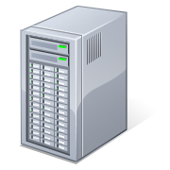
Centralized search logging and mining
Search:
Server-side logging
Raw data
Client-side logging
Logs:
- searches
- SERP clicks
- in-site navigation
Logs:
- searches (anywhere)
- clicks
- page views
- browser interactions
Stored information:
User/Session ID
IP Address
Timestamp
Action ...
lack of anonymity
no user control
Notes:
Introduce the centralized logging and mining model: server side and client side logging.

Slide 3
Centralized search logging and mining
Search:
Server-side logging
Raw data
Client-side logging
Logs:
- searches
- SERP clicks
- in-site navigation
Logs:
- searches (anywhere)
- clicks
- page views
- browser interactions
What’s the distribution of query reformulations over 3 months of logs?
Query 1 | Query 2 | Count
home depot | lowes | 835
myspace.com | yahoo.com | 619
craigslist | craigs list | 396
lack of sharability
...
Query reformulations from the AOL 2006 log.
Notes:
How a mining task is conducted: researchers from within the company ask a question, mine the data, and then get the data. The data cannot be released.

Slide 4
Centralized search logging and mining
Search:
Server-side logging
Raw data
Client-side logging
Logs:
- searches
- SERP clicks
- in-site navigation
Logs:
- searches (anywhere)
- clicks
- page views
- browser interactions
Show me all the actions performed by user 4417749.
Query | Clicks
care packages | www.awesomecarepackages.com, www.anysoldier.com
movies for dogs
blue book | www.kbb.com
lack of privacy
lack of anonymity
...
From the AOL 2006 log.
Notes:
A creepier example – researchers can ask “show me all of the searches entered by user X”. Even if anonymized ids are used, all the searches from that individual over some period can be seen.

Slide 5
Drawbacks of the centralized model for users and researchers
lack of user control
  raw search data is stored out of reach of users
lack of privacy
  raw data could contain personally identifiable information
  multiple user actions with common identifier
lack of anonymity
  source information logged (e.g., IP address)
lack of sharability
  logs not shared (privacy, legal, and competition issues)
  cannot reproducible research results
  stifles scientific process
Notes:
The advantages of crowdlogging

Slide 6
Outline
Centralized search logging and mining
CrowdLogging
  logging, mining, and releasing data
  advantages
  comparison with centralized model
The CrowdLogger browser extension
  overview
  collected data
Technical stuff
  secret sharing
  privacy policies (e.g., differential privacy)
See the paper
for details

Slide 7
CrowdLogging: how data is logged
User downloads browser extension or proxy
User’s web interactions logged locally
  can be examined and deleted at any time
Benefits:
  user control
Web
User
User
Log
User’s computer

Slide 8
CrowdLogging: how data is mined
Researchers request a mining experiment
User software pulls experiment request
User approves experiment
Extract search artifacts
E.g., query pairs: “home depot -> lowes”
Benefits:
  user control, sharability
Researchers
Web
Experiment
Router
User
User
Log
Mine
Experiment
Data
User’s computer
CrowdLogging Server
Notes:
Introduce the idea of EXTERNAL researchers asking to run mining experiments.

Slide 9
CrowdLogging: how data is encrypted
Each artifact is encrypted with:
  secret sharing scheme
  server’s RSA public key
Benefits:
  privacy
Researchers
Web
Experiment
Router
User
User
Log
Mine
Experiment
Data
Encrypt
User’s computer
CrowdLogging Server
Notes:
Not going to go in much detail about SSS, though I will mention that people should ask me offline about how SSS works (I have a slide at the end, plus a demo on my website). Privacy is protected two ways: 1. SSS ensures that artifacts must be shared by at least k users, making it less likely that sensitive artifacts will make it through (and if they do, it shouldn’t matter); 2. Eavesdroppers cannot sniff out the artifacts on the way to the server because they are encrypted.

Slide 10
CrowdLogging: how data is uploaded
Uploaded via an anonymization network
Prevents server from knowing the source of an encrypted artifact
Benefits:
  anonymity
  privacy
Researchers
Web
Experiment
Router
User
User
Log
Mine
Experiment
Data
Encrypt
Anonymizers
User’s computer
CrowdLogging Server
Notes:
Anonymous because the source cannot be told. Private because there is no way to say that two artifacts were generated by the same source.

Slide 11
CrowdLogging: how data is aggregated
Artifacts aggregated & decrypted
  artifacts must be shared by many different users*
A CrowdLog is born
Benefits:
  anonymity
  privacy
Researchers
Web
Experiment
Router
Mine
Experiment
Data
Anonymizers
Aggregate and
Decrypt
User
User
Log
Encrypt
Crowd
Log
User’s computer
CrowdLogging Server
* This can be made more or less strict according to the privacy protocol in use
Notes:
Anonymous because we don’t know the source of any artifact; private because we don’t know that two artifacts came from the same source, nor do we know know the contents of artifacts that are insufficiently supported.

Slide 12
CrowdLogging: how data is released
Researchers can access the CrowdLog
Benefits:
  sharability
Researchers
Web
Experiment
Router
Mine
Experiment
Data
Anonymizers
Aggregate and
Decrypt
User
User
Log
Encrypt
Crowd
Log
User’s computer
CrowdLogging Server

Slide 13
CrowdLogging advantages
  now have user control
    search data is logged and mined on users’ computers
  now have privacy
    mined data does not expose PII
  now have anonymity
    mined data is uploaded via an anonymization network
  now have sharability
    created with the idea of open access search data
Notes:
The advantages of crowdlogging

Slide 14
CrowdLog examples on AOL
Query CrowdLog (sample)
Query Click Pair CrowdLog (sample)
Query | User Count | Query Count
cheap tickets | 1 696 | 2 438
member rewards | 1 626 | 1 753
florida lottery | 1 596 | 3 410
free games | 1 392 | 1 869
chat | 1 391 | 1 996
jokes | 1 391 | 1 932
lottery | 1 360 | 3 076
dogs | 1 330 | 1 639
Query | Clicked URL | User Count | Query Count
dictionary | dictionary.reference.com | 4316 | 5629
lyrics | www.azlyrics.com | 1409 | 2135
www.yahoo.com | mail.yahoo.com | 1173 | 2056
dictionary | www.m-w.com | 1013 | 1415
myrtle beach | www.mbchamber.com | 99 | 106
song lyrics | www.musicsonglyrics.com | 95 | 103
...
...
Decryptable (user count > 5)
Decryptable (user count > 5)
Distinct Queries | Total Queries
248 030 (2.5%) | 8 620 013 (41.0%)
Distinct Query Click Pairs | Total Query Click Pairs
106 510 (1.9%) | 2 898 912 (31.6%)
Undecryptable
Undecryptable
Users | Distinct Queries | Total Queries
4 | 85 908 | 423 303
3 | 171 429 | 631 246
2 | 510 602 | 1 241 115
1 | 9 138 773 | 10 097 419
Users | Distinct Query Click Pairs | Total Query Click Pairs
4 | 40 906 | 197 944
3 | 84 080 | 304 326
2 | 259 517 | 613 674
1 | 4 910 665 | 5 169 520
Notes:
An example of the data revealed in the AOL query logs, as well as the summary data of the non-revealed data. [Undecryptable data using the FT_{u} privacy policy.]
Add query-click

Slide 15
Outline
Centralized search logging and mining
CrowdLogging
  logging, mining, and releasing data
  advantages
  comparison with centralized model
The CrowdLogger browser extension
  overview
  collected data

Slide 16
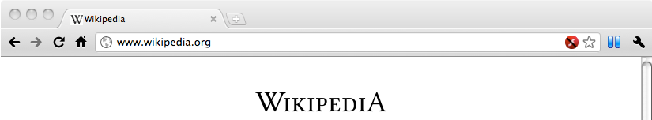
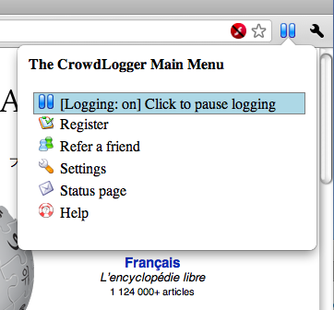
CrowdLogger
In-page search capture:
  Bing
  Google
  Yahoo!
Handles Google instant
Ignores HTTPS URL parameters
Automatic removal of SSN/phone number patterns
No logging while in “Privacy” or “Incognito” modes
Notes:
Some screen shots of the crowdlogger browser extension and how it is used.

Slide 17
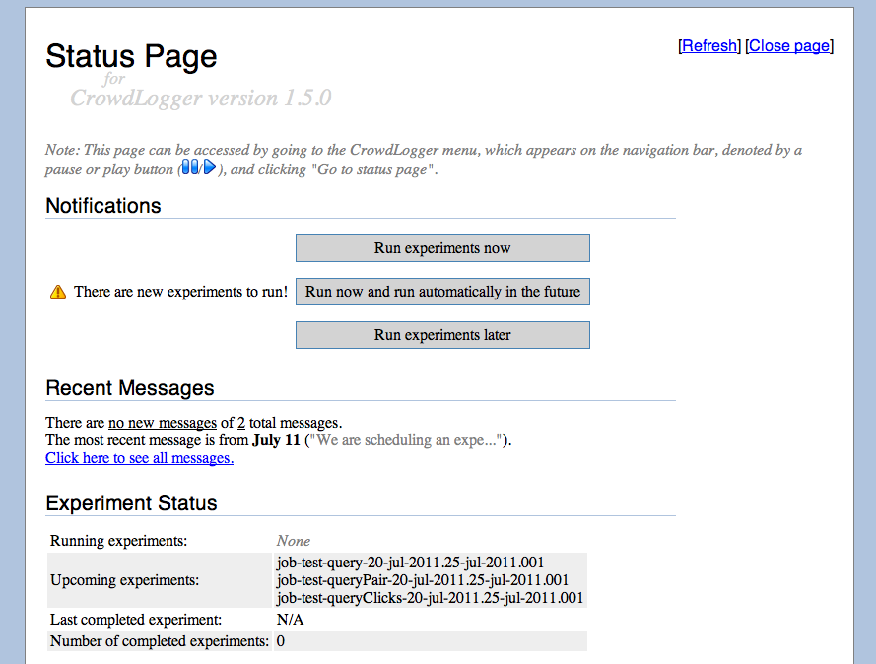
CrowdLogger
Notes:
Some screen shots of the crowdlogger browser extension and how it is used.

Slide 18
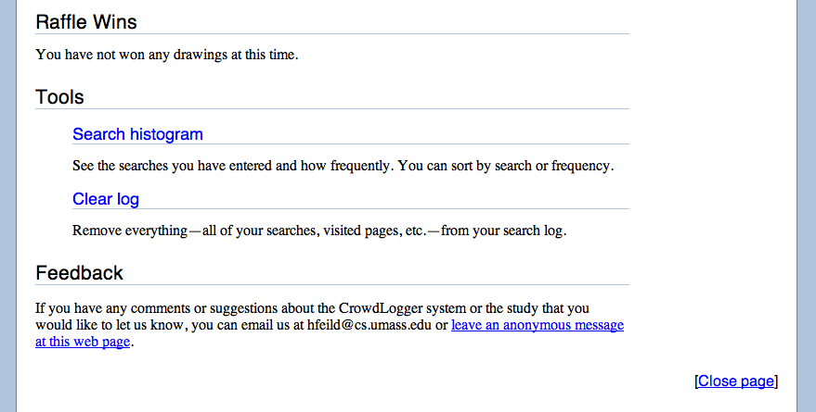
CrowdLogger
Notes:
Some screen shots of the crowdlogger browser extension and how it is used.

Slide 19
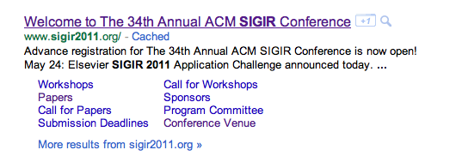
CrowdLogger data
63 downloads
34 distinct registered users
currently cannot release data ☹
Queries:
  sigir 2011, cikm 2011, wsdm 2012
Query click pairs:
  cikm 2011 -> www.cikm2011.org
  wsdm 2012 -> wsdm2012.org
Notes:
Stats about what we’ve collected so far. What we put here will be largely dependent on what we collect.

Slide 20
Summary
CrowdLogging
  a new way to collect and mine search data
  it’s private, distributed, and anonymous
  less useful, more practical then centralized data
CrowdLogger
  an implementation for Chrome and Firefox
  join the study and download: http://crowdlogger.org
  questions/suggestions? email: info@crowdlogger.org

Slide 21
Thanks
Notes:
Buffer slide.

Slide 22
Secret Sharing
Start with: artifact, k, user’s pass phrase, experiment ID
Deterministically pick some key = genKey( artifact + experiment ID )
  Range( genKey ) = [0, very large prime]
Deterministically pick k numbers n given artifact + experiment ID
Create a polynomial f(x) = y + n₁*x + n₂*x² + ... + n_{k}*x^{k}
Set x = genX( artifact + pass phrase )
  Range( genX ) = R+
Symmetrically encrypt artifact using key
Send off with: [ enc( artifact, key ), x, f( x ) ]
...
To find key, interpolate with at least k different (x, f(x)) pairs
Demo:
http://ciir.cs.umass.edu/~hfeild/ssss
key
Interpolated polynomial for some given artifact + experiment ID combination.
f(x)
x
Notes:
This is for use off line if anyone wants to know more about SSS.

Slide 23
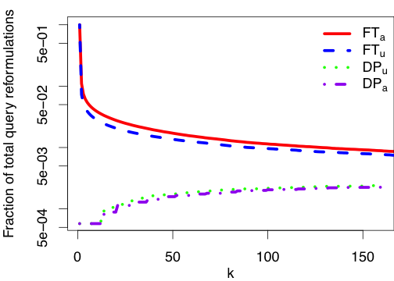
CrowdLogging vs. Centralized logging
Query Reformulations on AOL
50%
5%
5%
4%
0.5%
0.06%
0.06%
0.05%
5
Notes:
This shows the less useful side of CrowdLogging – only 4% of query pairs! An analysis of artifact representation would likely help us find a more utility-friendly representation.

Slide 24
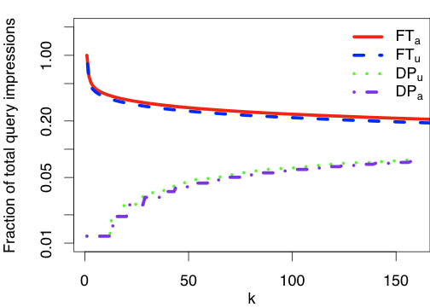
CrowdLogging vs. Centralized logging
Query Counts on AOL
100%
45%
41%
20%
5%
1%
1%
1%
5
Notes:
Query counts mined from AOL. We only mentioned FTu, so I’ll briefly explain that there are other privacy policies (how we decide which artifacts to expose) and point out that the ones at the bottom are the differential privacy methods. The performance of the DP methods could likely be improved.

Slide 25
CrowdLog examples on AOL
Query CrowdLog (sample)
Query Pair CrowdLog (sample)
Query | User Count | Query Count
cheap tickets | 1 696 | 2 438
member rewards | 1 626 | 1 753
florida lottery | 1 596 | 3 410
free games | 1 392 | 1 869
chat | 1 391 | 1 996
jokes | 1 391 | 1 932
lottery | 1 360 | 3 076
dogs | 1 330 | 1 639
QueryA | QueryB | User Count | Query Count
weather | wheather | 70 | 73
ups | usps | 64 | 81
greyhound | amtrak | 63 | 65
american idol results | american idol | 62 | 63
internet | webunlock | 54 | 55
fredericks of hollywood | fredricks of hollywood | 53 | 60
mycl.cravelyrics.com | bad day lyrics | 53 | 62
...
...
Decryptable @ k = 5
Decryptable @ k = 5
Distinct Queries | Total Queries
248 030 | 8 620 013
Distinct Query Pairs | Total Query Pairs
46 267 | 792 864
Undecryptable @ k = 5
Undecryptable @ k = 5
Users (k) | Distinct Queries | Total Queries
4 | 85 908 | 423 303
3 | 171 429 | 631 246
2 | 510 602 | 1 241 115
1 | 9 138 773 | 10 097 419
Users (k) | Distinct Query Pairs | Total Query Pairs
4 | 21 228 | 95 469
3 | 48 380 | 163 696
2 | 186 721 | 425 921
1 | 18 380 942 | 18 877 722
Notes:
An example of the data revealed in the AOL query logs, as well as the summary data of the non-revealed data. [Undecryptable data using the FT_{u} privacy policy.]
Add query-click

Slide 26
CrowdLog examples on AOL
Query Click Pair CrowdLog (sample)
Query | Clicked URL | User Count | Query Count
dictionary | http://dictionary.reference.com | 4316 | 5629
lyrics | http://www.azlyrics.com | 1409 | 2135
www.yahoo.com | http://mail.yahoo.com | 1173 | 2056
dictionary | http://www.m-w.com | 1013 | 1415
myrtle beach | http://www.mbchamber.com | 99 | 106
song lyrics | http://www.musicsonglyrics.com | 95 | 103
...
Decryptable @ k = 5
Distinct Query Click Pairs | Total Query Click Pairs
106 510 | 2 898 912
Undecryptable @ k = 5
Users (k) | Distinct Query Click Pairs | Total Query Click Pairs
4 | 40 906 | 197 944
3 | 84 080 | 304 326
2 | 259 517 | 613 674
1 | 4 910 665 | 5 169 520
Notes:
An example of the data revealed in the AOL query logs, as well as the summary data of the non-revealed data. [Undecryptable data using the FT_{u} privacy policy.]
Add query-click

